Slide 1
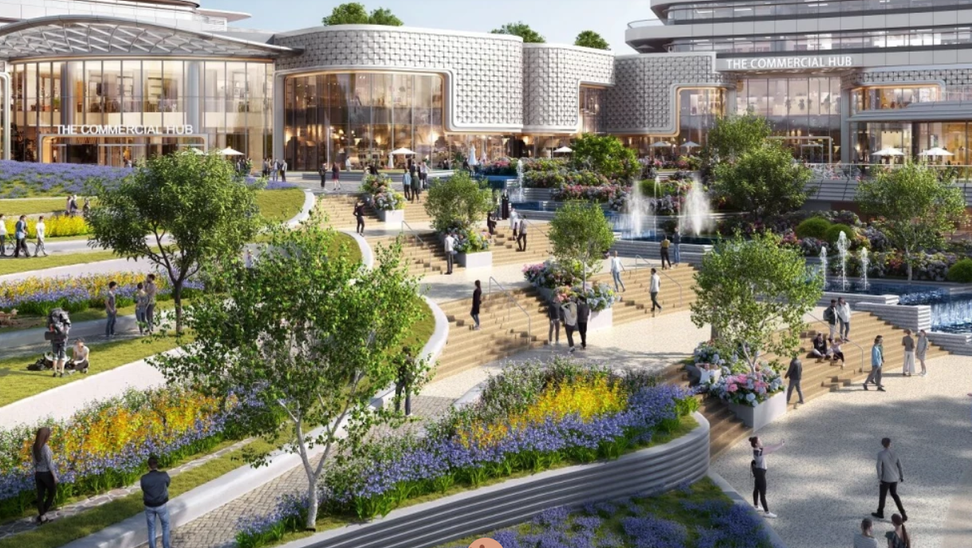
Customer
Segmentation Using
Unsupervised Machine Learning

Slide 2


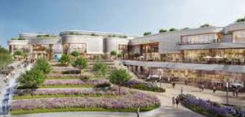


Project Overview & Dataset
Team
Members
Dataset: Mall Customer Segmentation(Kaggle)
Samples:1000
Target : Client Clustering
Vasia Galanopoulou
Vasiliki Nterkou
Dataset Info
Angeliki Triantafyllou

Slide 3

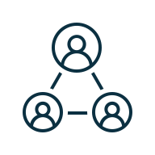


Dataset Overview & Processing
Features
Preprocessing
Drop Unneeded column
Handle missing values
Encode categorical data
1
Gender (M, F)
Age (18–80)
Annual income in thousand
USD (15–150)
Spending Score (1–100)
K-means Clustering
Apply 5 clusters
Assign labels
2
Results
Who are the main types of customers?
Which customers spend the most?
Which customer segments have the potential to increase their spending?
3

Slide 4
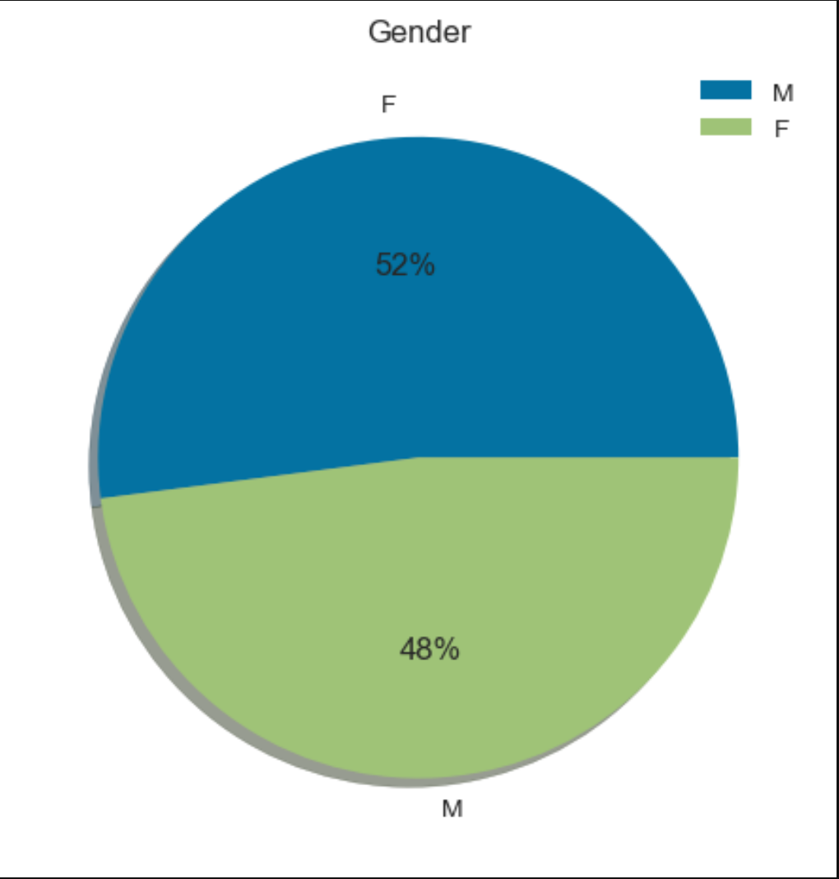
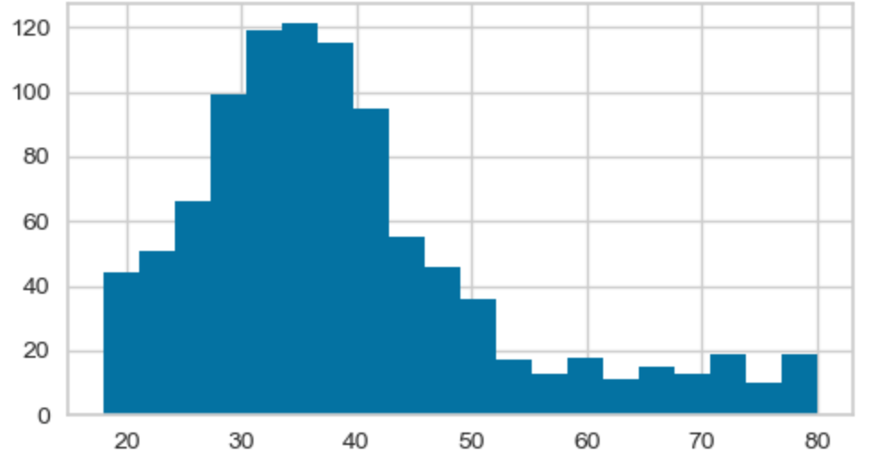
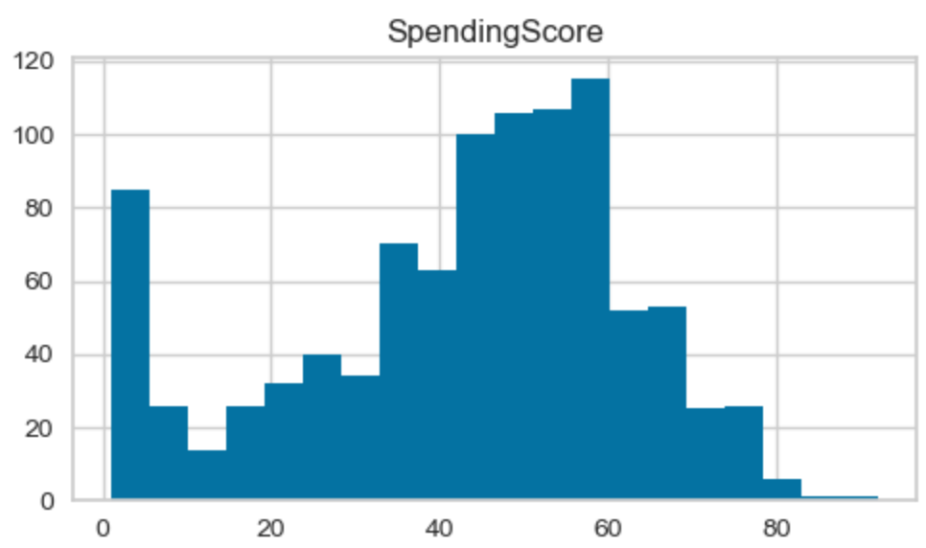
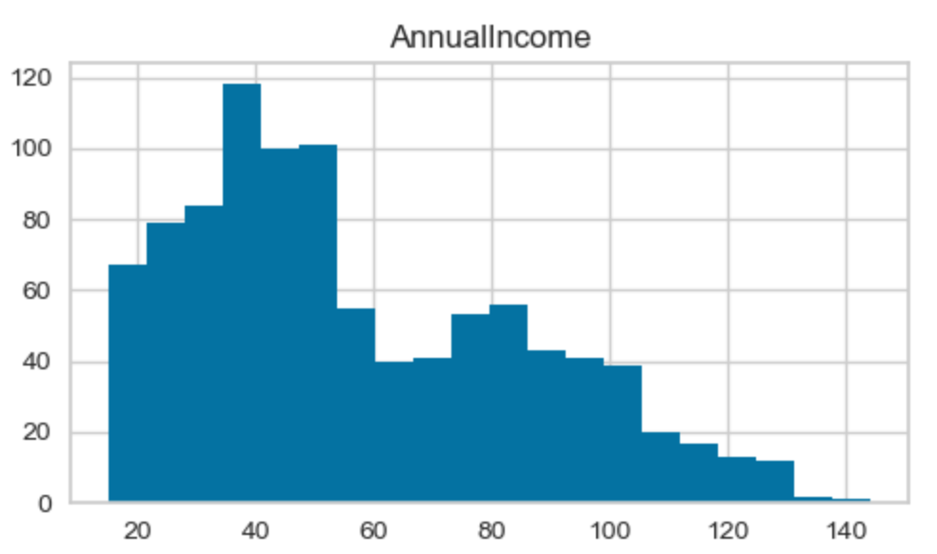
Demographic Analysis of Customers
Gender
Age
Spending Score
Annual Income

Slide 5
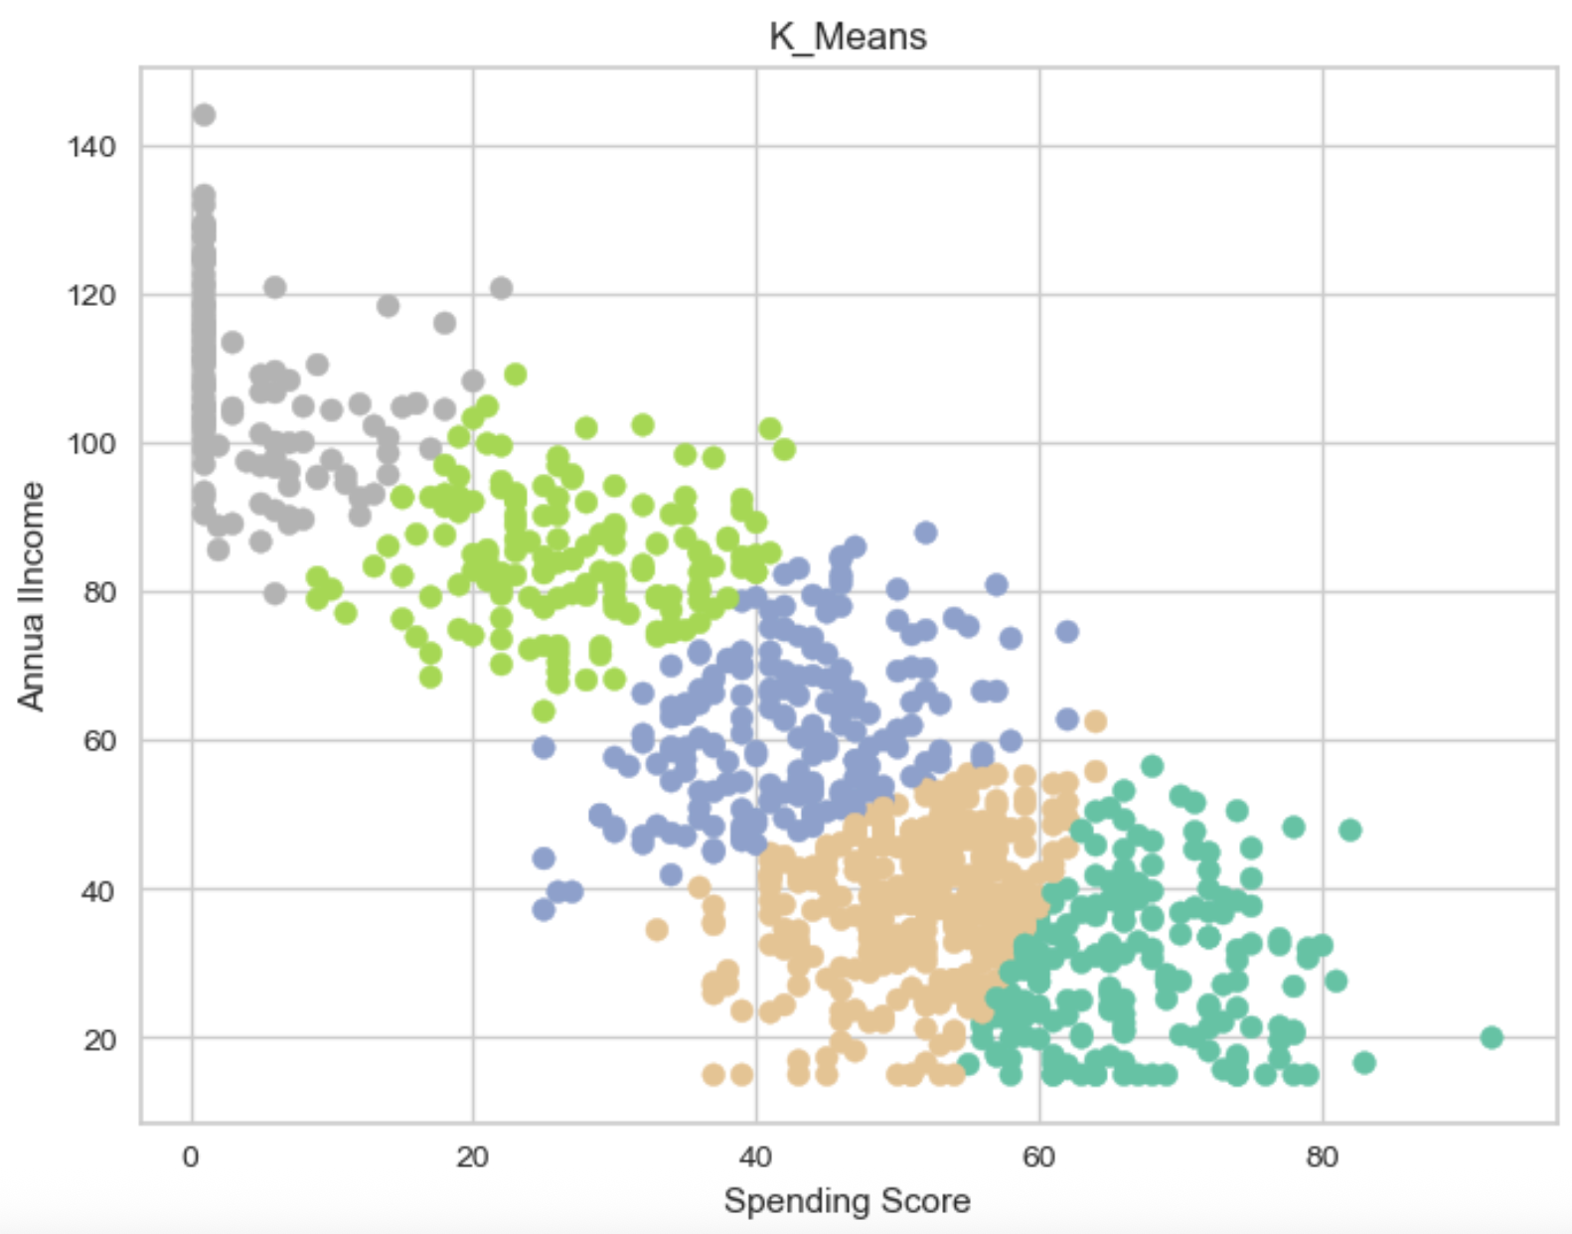
K-Means Clustering of Customers
K-Means

Slide 6
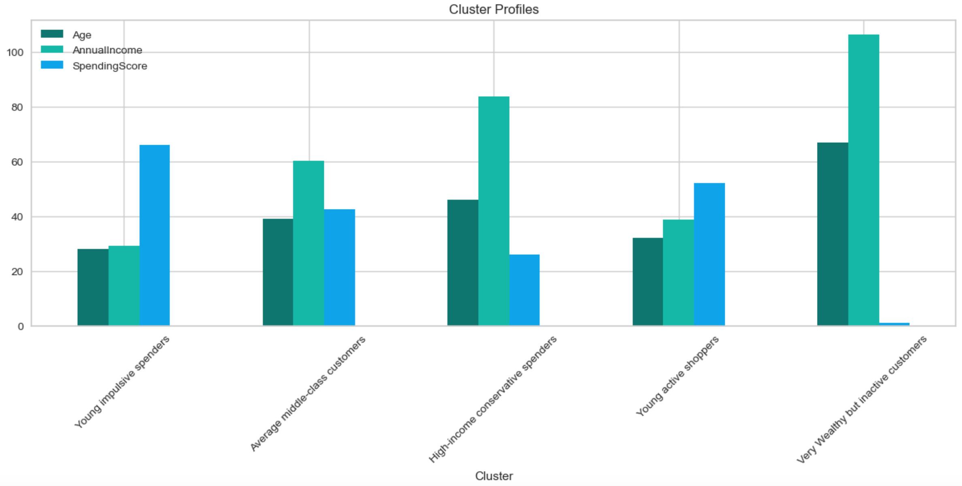
Cluster Profiles Overview
Cluster Profiles

Slide 7
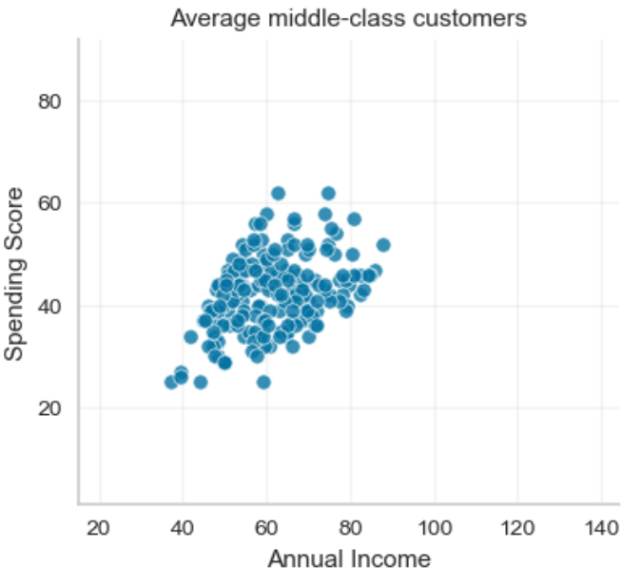
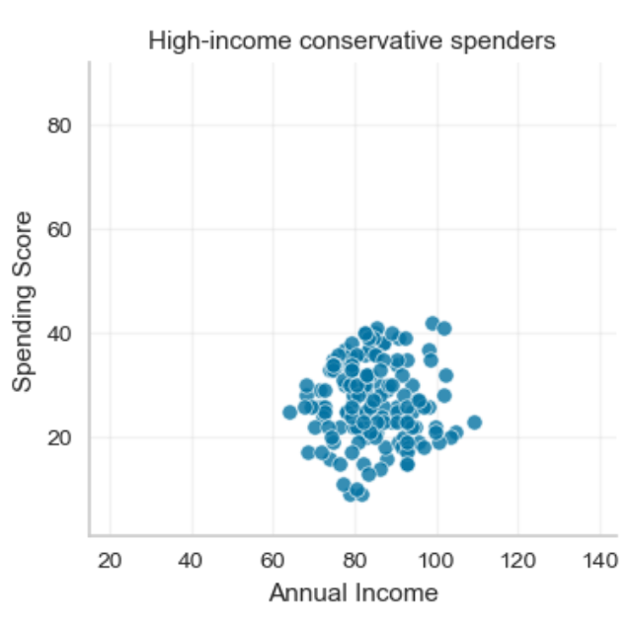
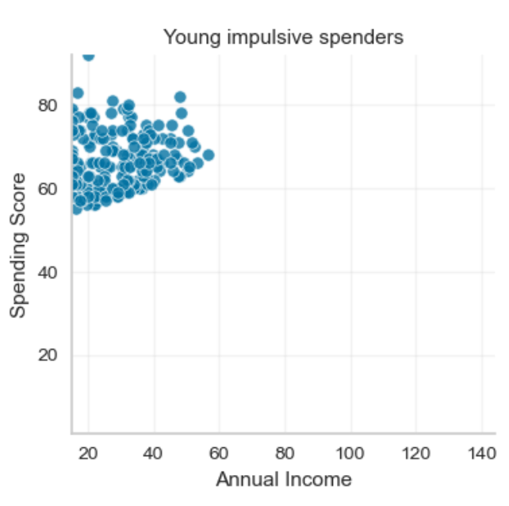

K-Means Clustering of Customers(1/2)
Young Impulsive Spenders
Average middle-class customers
High-income conservative spenders
Insights
Characteristics: • Mean Age: 28 • Mean Annual Income: 29k • Mean Spending Score: 66
Characteristics: • Mean Age: 39 • Mean Annual Income: 60k • Mean Spending Score: 42
Characteristics: • Mean Age: 46 • Mean Annual Income: 83k • Mean Spending Score: 26
Marketing strategy: • Flash sales • Social media ads • Limited offers • Influencer marketing
Marketing strategy: • Loyalty programs • Personalized promotions • Seasonal offers
Marketing strategy: • Premium experiences
• Exclusive offers
• Luxury branding

Slide 8
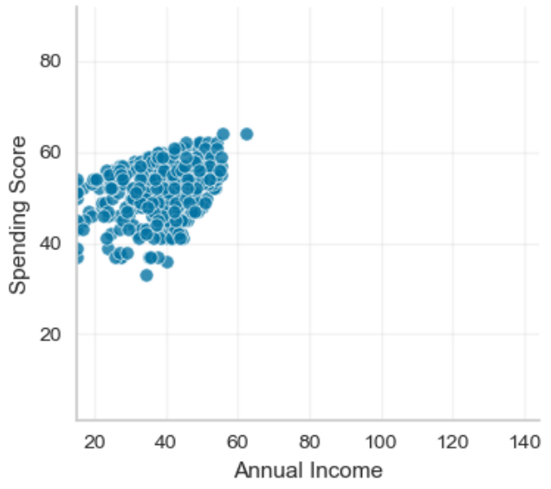
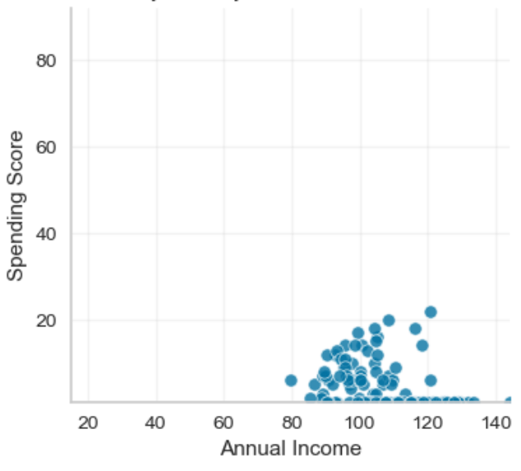
K-Means Clustering of Customers(2/2)
Young active shoppers
Very Wealthy but inactive customers
Insights
Characteristics: • Mean Age: 32 • Mean Annual Income: 39k • Mean Spending Score: 52
Characteristics: • Mean Age:67 • Mean Annual Income: 106k • Mean Spending Score: 1
Marketing strategy: • Membership programs
• Bundles
• Frequent buyer rewards
Marketing strategy: • Luxury experiences
• Personalized premium services
• Exclusive VIP events

Slide 9
Thank You!

